Slide 1


Problem Statement – GramSeva Health

Slide 2
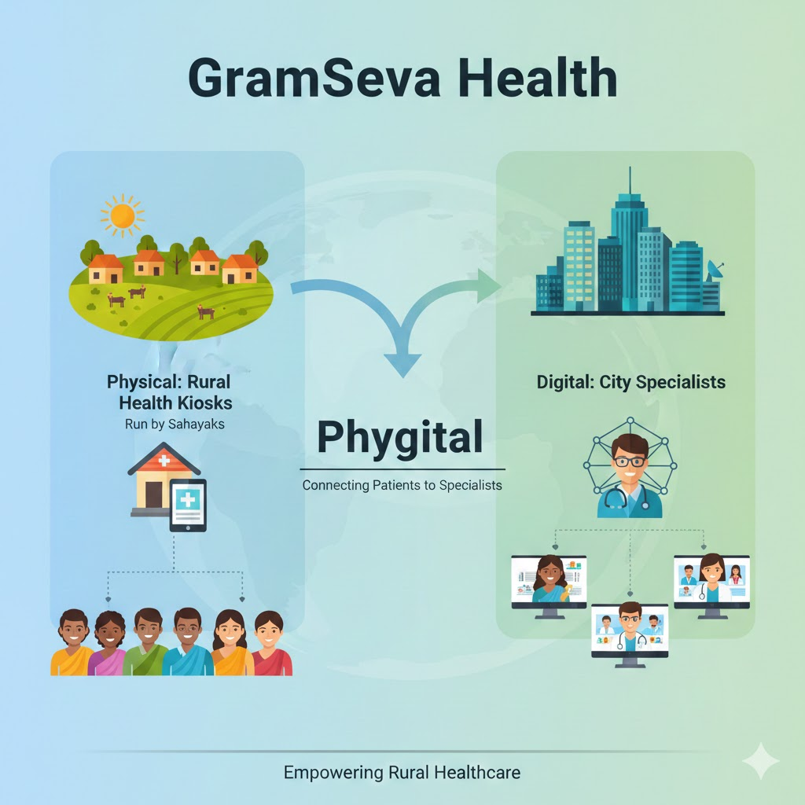
GramSeva Health
Kata Topic
A social enterprise wants to build a "Phygital" (Physical + Digital) healthcare network connecting rural patients with city-based specialists via local "Health Kiosks" run by trained intermediaries (Sahayaks).
Business Objectives:
Reduce the travel burden on rural patients by filtering non-critical cases through remote consultation.
Empower local health workers (Sahayaks) with digital tools to capture accurate vitals and patient history.
Overcome language and literacy barriers in medical diagnosis and prescription understanding.
Ensure continuity of care for chronic conditions (diabetes, hypertension) prevalent in rural India.

Slide 3
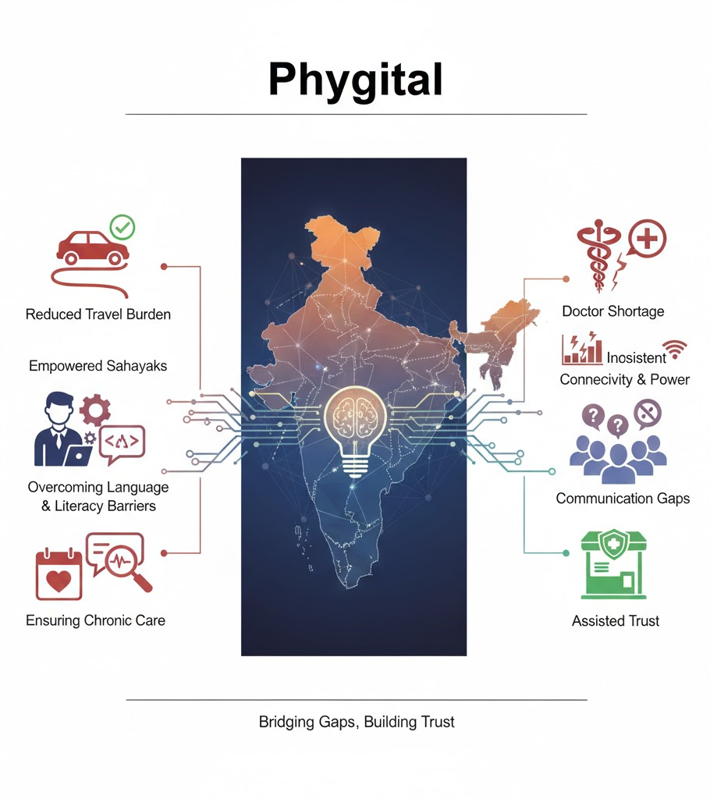
Context
Network connectivity is improving (4G/5G) but remains inconsistent; power outages are common.
Patients often struggle to describe symptoms accurately to remote doctors due to dialect differences.
Trust is physical; patients prefer an assisted model (Kiosk) over a pure DIY app.
Tier-2/3 cities and villages suffer from a severe shortage of qualified doctors.

Slide 4
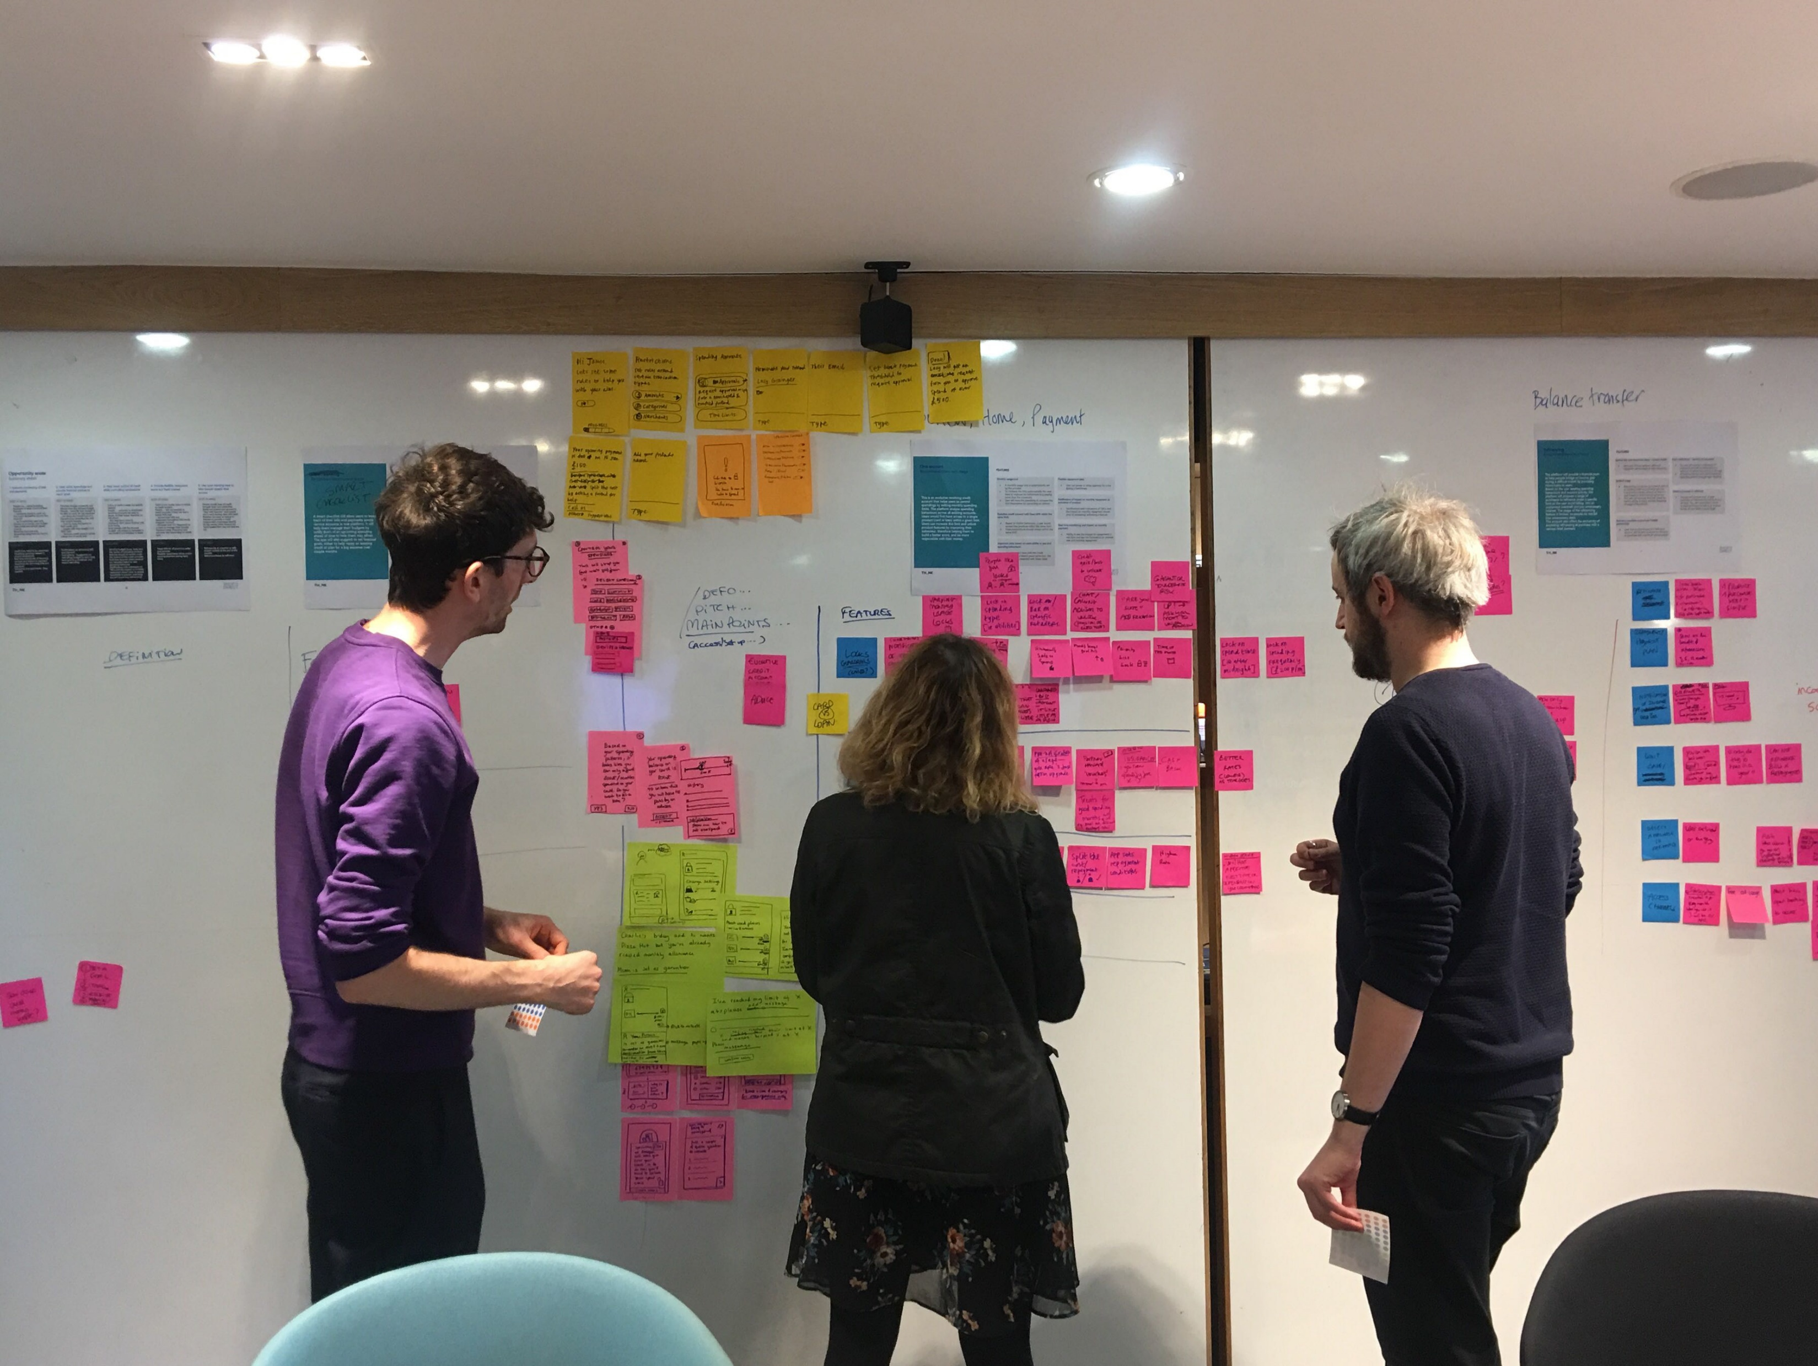
Key Requirements
Assisted Tele-Consultation Platform:
Video consultation module optimized for low bandwidth, allowing the Sahayak (intermediary) to upload vitals from IoT devices (BP monitor, Oximeter) directly to the doctor’s screen.
AI-Powered Triage & Translation:
A GenAI bot that listens to the patient's symptoms in local dialect, translates them to English medical summaries for the doctor, and suggests a preliminary severity score.
Prescription & Fulfillment Engine:
Digital prescription generation that integrates with local pharmacy supply chains for medicine delivery.
Offline Sync & Storage:
"Store and Forward" architecture to cache patient data locally when the internet is down and sync when connectivity is restored.
Consent & Privacy (DPDP Act Compliance):
Strict role-based access control ensuring Sahayaks can only see data for active patients, with explicit consent management (OTP/Biometric) for sharing records.

Slide 5
Nice To Have
Visual Diagnosis Aid :
Computer Vision tools for skin conditions/wounds analysis to assist general practitioners in preliminary assessment.
Govt Scheme Integration:
API integration with Ayushman Bharat (ABHA IDs) to verify insurance eligibility and fetch past health records.
WhatsApp Bot for Follow-ups:
Automated vernacular reminders for medication dosage and follow-up appointment scheduling.

Slide 6
Thank you!

